Slide 1

A Bibliometric Portfolio Analysis
January 26, 2022
Thomas Houze
Program Officer
Preclinical, DAIDS, NIAID

Slide 2
Introduction
A total Biblioinformatic grant application analysis of the grant portfolio of the Preclinical Branch of the Division of AIDS research DAIDS at the NIH was carried out using software obtained from the Office of Portfolio Analysis at the NIH. This analysis provided for insights into the nature and content of the portfolio which even though known was not quantified nor where the hidden relationships and attributes revealed to the extent possible by this software prior to this analysis.
Notes:
A total Biblioinformatic grant application analysis of the grant portfolio of the Preclinical Branch of DAIDS at the NIH was carried out.
The analysis was performed using software obtained from the Office of Portfolio Analysis (OPA) at the NIH.
This analysis provided for insights into the nature and content of the portfolio which even though known was not quantified,
nor where the hidden relationships and attributes of this portfolio revealed to the extent possible before this analysis.

Slide 3
Contents
Introduction
Results
iSearch & iCite: Bibliometric analysis
IN-SPIRE: Themematic analysis
Conclusions
iSearch & iCite
IN-SPIRE
Notes:
Order of appearance with Introduction followed by Results and the Conclusions

Slide 4
iSearch & iCite
Notes:
A total Biblioinformatic grant application analysis of the Preclinical Branch of DAIDS using iCite following rollout by iSearch

Slide 5
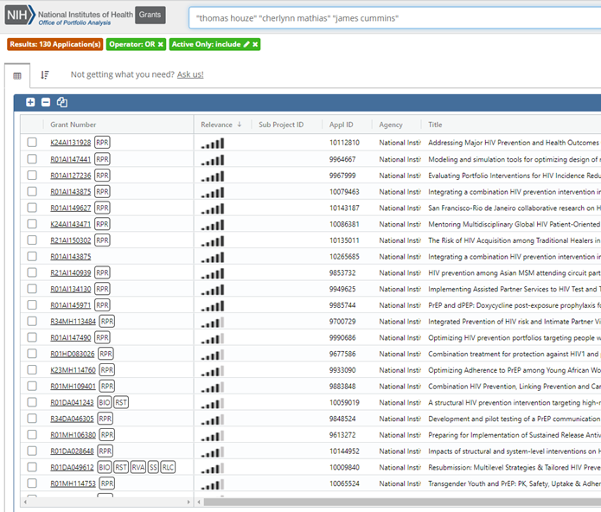
Results of iSearch: Total Active Grant Applications (130) being Processed by POs at the Preclinical Branch
Notes:
Three bibliometric analysis were carried out revealing various aspects of the 2051 publications produced by the 130 grant applications in the Preclinical application portfolio.
At first a preliminary search is performed using iSearch. The search yielded 130 applications and was performed using the names of the Program Officers in the Preclinical Branch at DAIDS.
The software used in the three analysis were provided by the Office of Portfolio Analysis and the names respective of the order of the analysis are used in iSearch and iCite; IN-SPIRE.

Slide 6
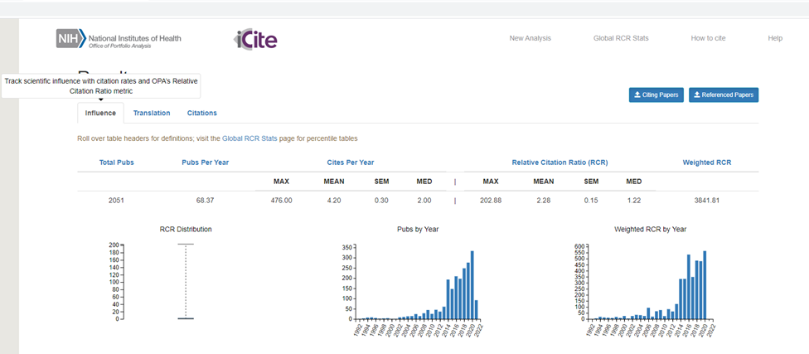
Results iCite (Influence): Portfolio Analysis of Preclinical
Notes:
What was obtained with the iCite software package were three tabs which measured the Influence , Translational ability , and number of Citations that are related to the 130 grant applications in the Preclinical portfolio.
In this first example we look at the results of the Influence tab which tracks scientific influence with citation ratio metric. This tab reveals that there were a total of 2051 publications with an approximate 68.37 publications per year.
The sub tab called Relative Citation Ratio (RCR) reveals the Maximum (MAX) column with a value of 202.88 citations/year for one of the applicants and a Median relative citation RCR of 1.22 compared to the average citation rate at the NIH which is a measure of 1.0.
The meaning of which is that this portfolio produced 0.22 (22% more) citations that the average grant application portfolio at the NIH.

Slide 7
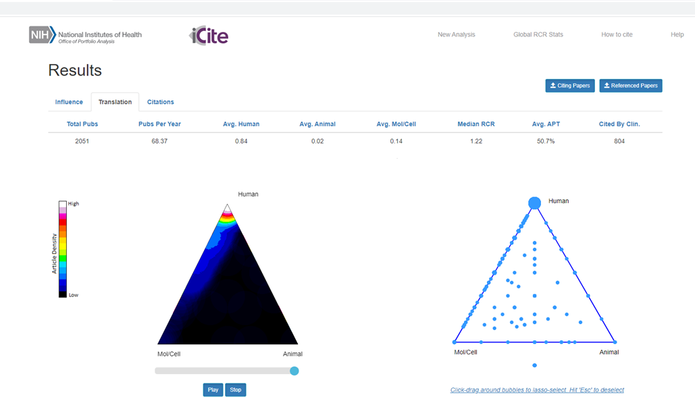
Translation: Portfolio Analysis of Preclinical
Notes:
The Translation tab which is next provides for measures that track and predict the translation of scientific knowledge into clinical studies. Where the “Cited by Clin.” sub-tab shows there were 804 citations by clinicians.
Underneath the sub-tab we see that there are two triangles with very high concentrations of effort (bright colors) associated with the upper left-hand quadrant of the triangle which shows a heavy emphasis on molecular and cell biology accompanied by a red-hot and white-hot apex which reveals
The heavy translational nature of this portfolio with heavy emphasis in the last 10 years which is more clearly illustrated in the following animation.

Slide 8
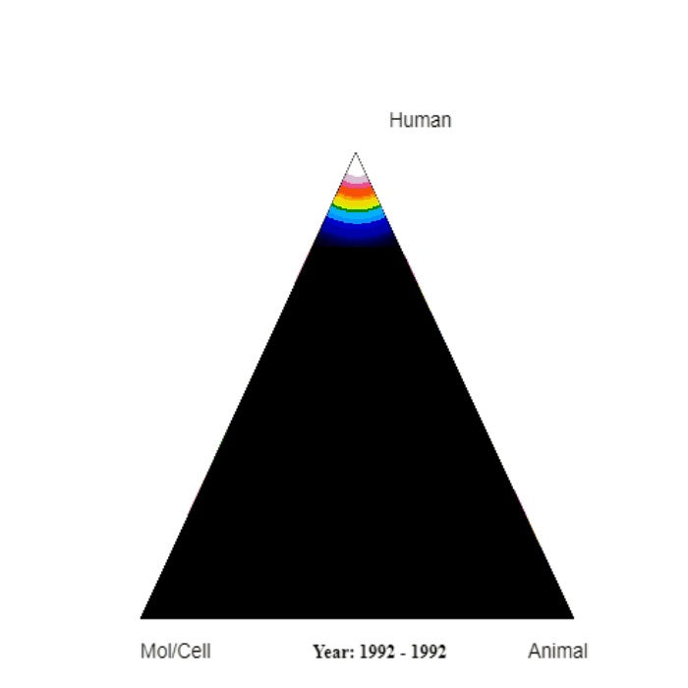
Translational Evolution: Portfolio Analysis of Preclinical
Notes:
The animation in this slide reveals the research activity over time. The years are ticking away center-right of the triangle with the colors representing the research activity of grantees in the Preclinical Branch from 1992 to the present.
In this animation, there is initially low publication activity (colored blue) in circa 1992 to 1998 on the right-hand side of the triangle.
This activity represents initial Preclinical Branch activity at a relatively low (blue level) with an initial heavy emphasis on using research animals.
Over time, this initial activity is equaled by publishing effort in Cell and Molecular Biology, which is represented by the similarly blue-colored activity but this time on the left side of the triangle.
Note that this represents a significant shift in research activity from almost exclusively using research Animals to using more Cell and Molecular Biology scientific research efforts, which dominates the research efforts within Preclinical.
The above is followed by (circa 2010-2013) the ascent of research activity along the left side of the pyramid toward Human, directed toward the clinic.
This activity continues towards the apex of the triangle in the early 2010s, revealing a high-level of Translational activity in the Preclinical Branch towards human health, which eventually in the late 2010s results in a red-hot and then white-hot triangle apex with the most recent activity at a super high level of translation of Preclinical research activity to the improvement of human health.

Slide 9
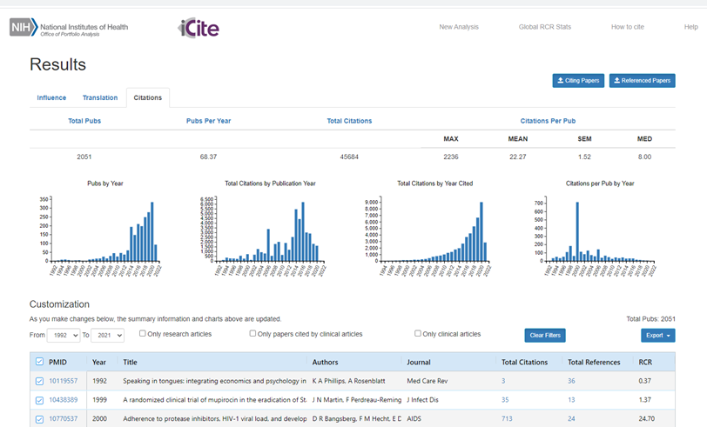
Citation: Portfolio Analysis of Preclinical
Notes:
The last and 3rd tab of the iCite software application reveals its ability to get free and open link-level citation data directly from databases.
This metric is an important tool by which the significance of the effort Preclinical Branch’s grant applicants can be measured in terms of the number of fellow scientist who cite their papers in their research papers.

Slide 10
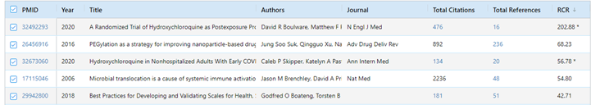
Top Five (Cited) RCR Scores: Portfolio Analysis of Preclinical
Notes:
Upon sorting the RCR scores for publications resulting from work funded by the NIH within the grant applicants in the Preclinical Branch’s portfolio the five highest RCR scores range from a high value of 202.88 to a low value of 42.71 of citations which is again in relation to the relative RCR ratio of 1.0 when compared to the citations of all NIH funded researchers. Noticeable, two of the highest scoring RCR values are attributed to research efforts directed toward therapeutics against the COVID-19 coronavirus induced pandemic and again shows the high adaptability of Preclinical researchers in addressing the need to apply there retrovirology methodology to improving human health .

Slide 11
IN-SPIRE: Portfolio Analysis

Slide 12
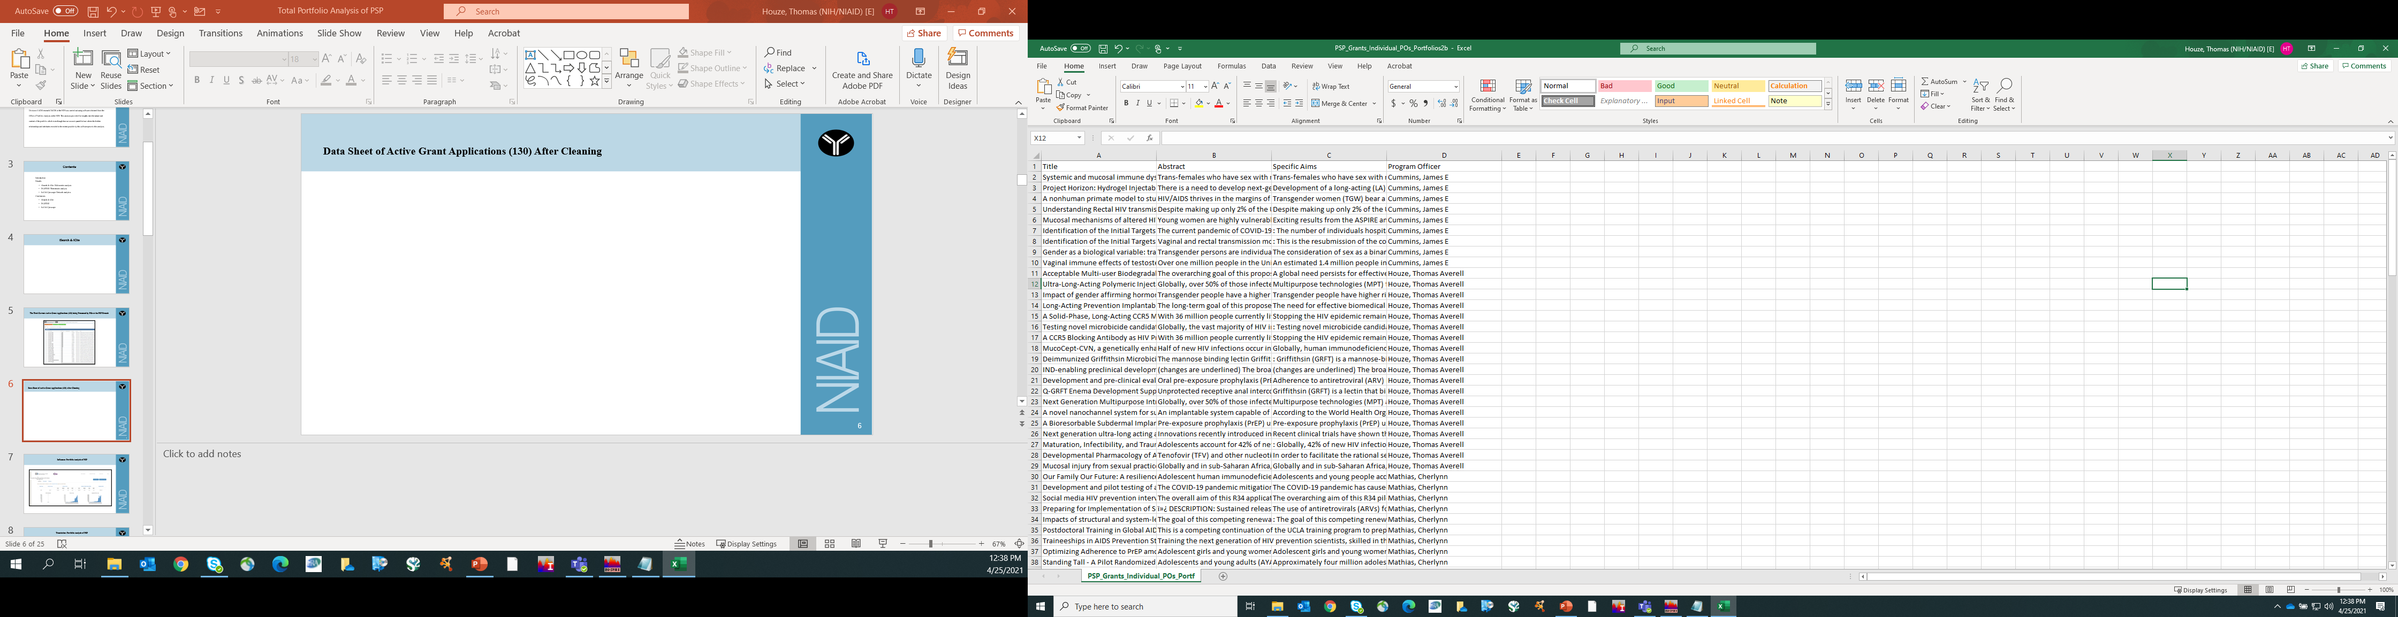
Data Sheet of Active Grant Applications after Cleaning
Notes:
The iSearch results are now cleaned and saved in Comma Separated Values (CSV) in an Excel Workbook. This is the data that will be used in the subsequent IN-SPIRE portfolio analysis.

Slide 13
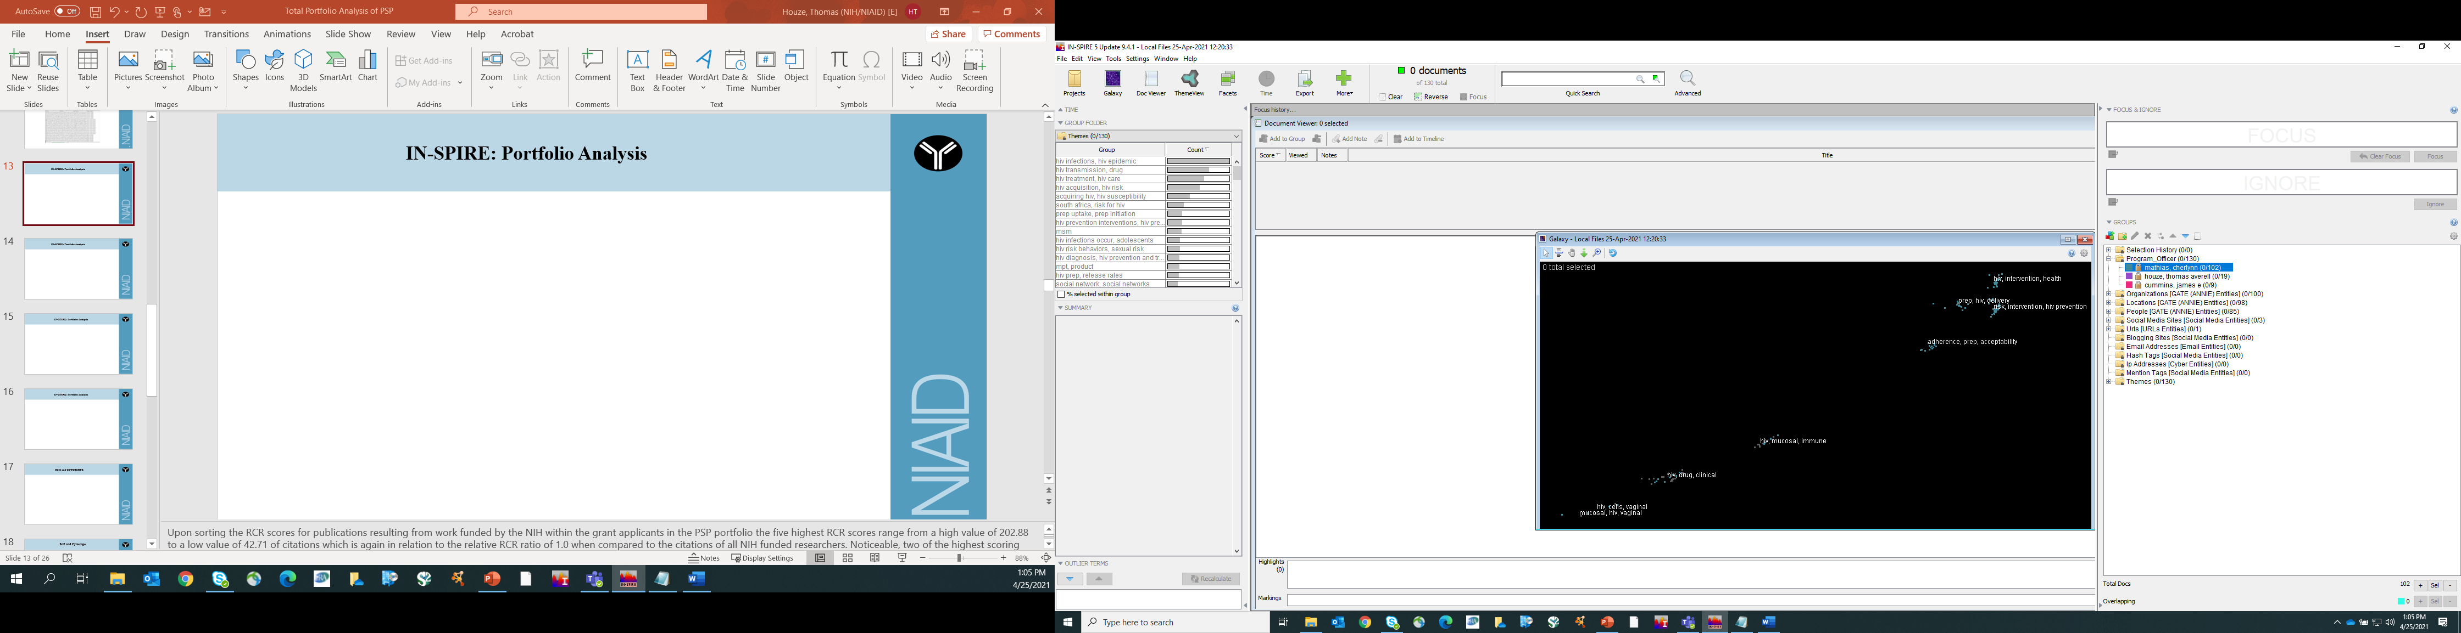
IN-SPIRE: Galaxy Clusters – PO Cherlynn Mathias
Notes:
This is the Galaxy view highlighting in light blue color the clusters to which Program Officer Cherlynn Mathias’ one hundred and two grant applications are members of, also please note the tabs to the right of the image. Each of these folders contains aspects which are associated with the Categories in this case the names of Program Officers are categorical attribute: they have a one-to-many relationship with the 130 portfolios or, Theme attributes which are the computational attributes used in this cluster analysis.
From within IN-SPIRE the clusters produced are representations of the relationships (3-D signature) of computational values of the text (word and phase) attributes of the first three columns (Title, Abstract, and Specific Aim) of the Workbook and clustered in Three-Dimensional (X,Y,Z) space but represented here in a Two-Dimensional plane. Because the values are presented in 2-D some values may seem closer than they are nevertheless the IN-SPIRE software uses the computational analysis of the text contents of the documents to cluster them based upon the similarity of their text, text order, and arrangement into ‘text signatures’ which are formed into clusters of similar documents.

Slide 14

IN-SPIRE: Galaxy Clusters – PO Thomas Houze
Notes:
Please note the dots highlighted in purple which denote the clusters to which Program Officer Thomas Houze nineteen applications belong within the grant application landscape.

Slide 15

IN-SPIRE: Galaxy Clusters – PO James Cummins
Notes:
As well as the dots highlighted in violet which denote the clusters where Branch Chief James Cummins nine applications exist within the grant application landscape.

Slide 16
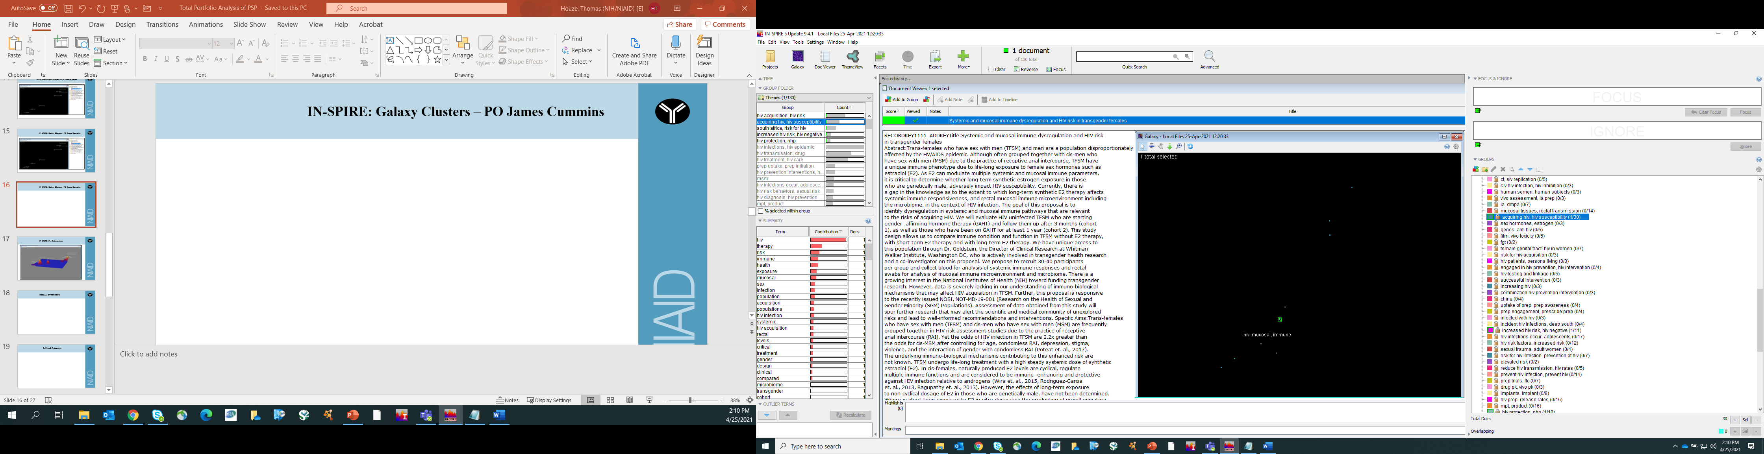
IN-SPIRE: Galaxy Clusters – PO James Cummins
Notes:
Within the Galaxy View one can drill-down into clusters, in this example one of James's clusters, and pick out one or a group of documents and review the content of those documents and or select and save those documents for subsequent view or analysis…

Slide 17
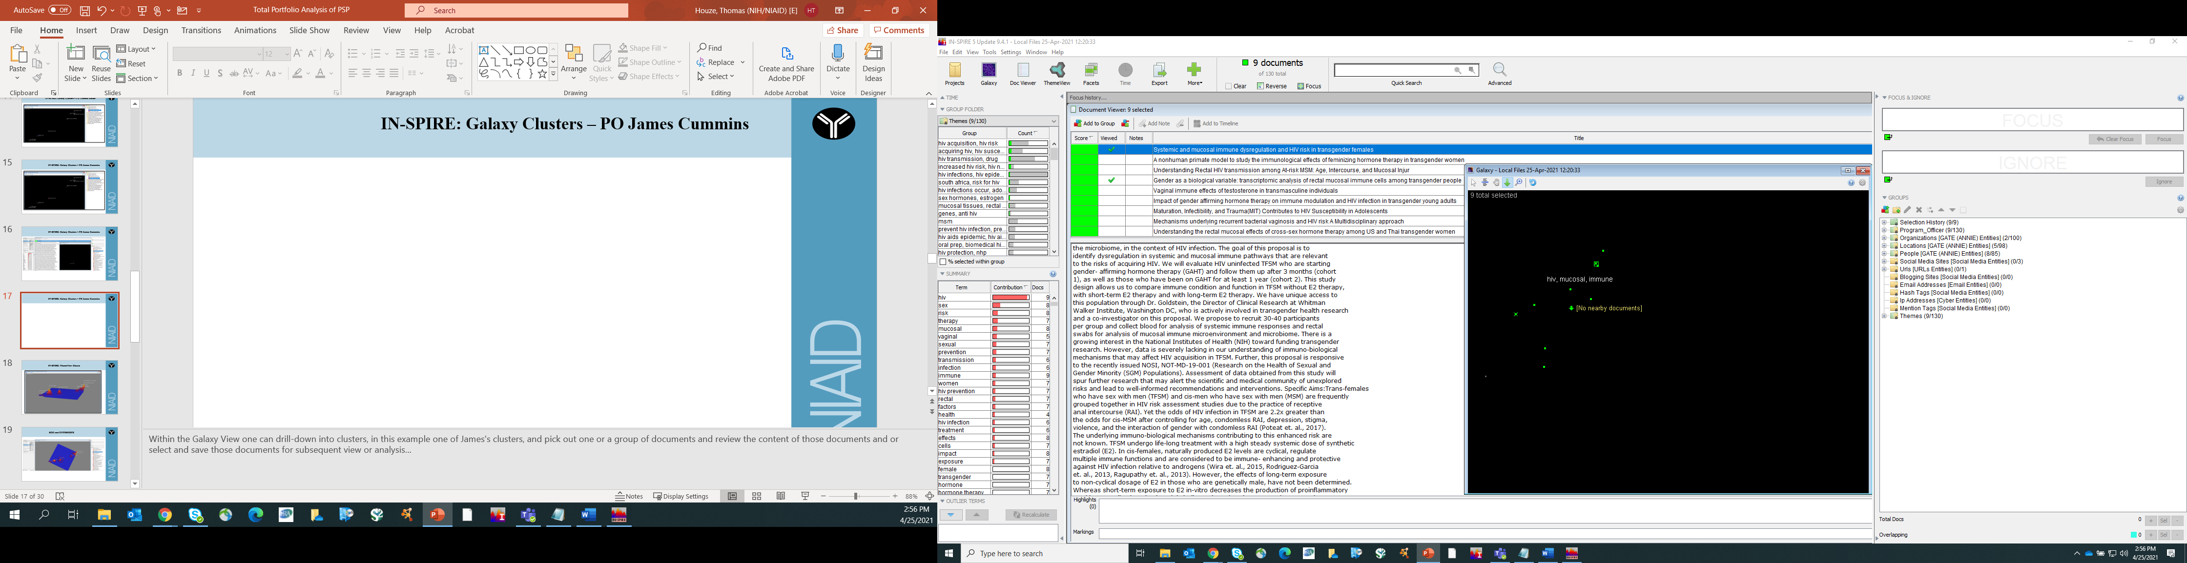
IN-SPIRE: GalaxyView with 9 Documents in SelectView
Notes:
Within the Galaxy View one can select groupings of clusters, in this example 9 documents are selected, and their titles are displayed in the upper left quadrant where each one of James's clusters represents a document where again the contents of these documents can be saved for subsequent viewing or analysis.

Slide 18
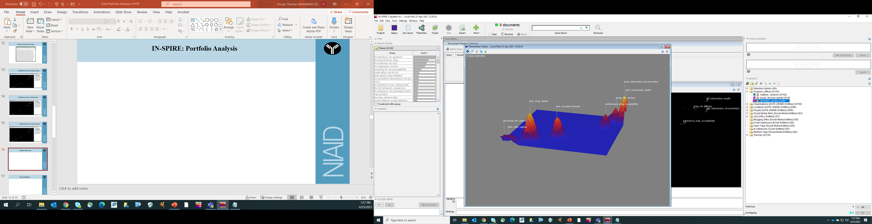
IN-SPIRE: ThemeView Classic
Notes:
This is the ThemeView within IN-SPIRE which presents a 3D topographic view of the locations within the Themematic landscape of the various clusters but also the intensity of the activity (height) of each of these cluster relative to one another within the landscape.

Slide 19
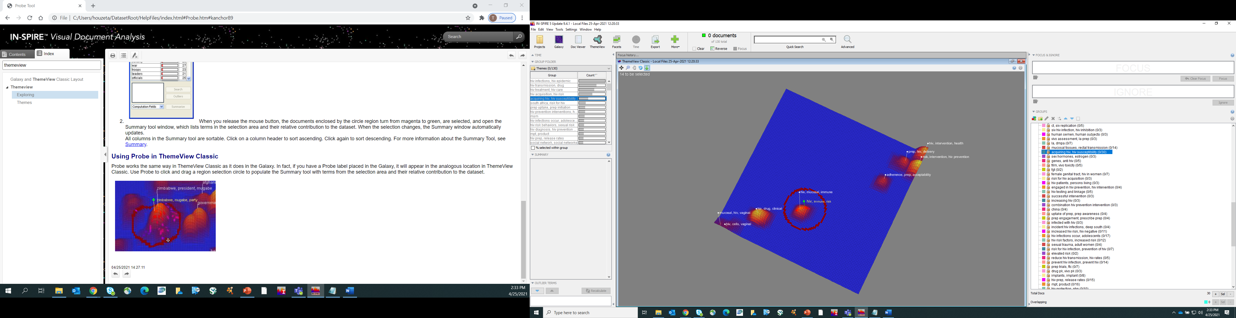
IN-SPIRE: ThemeView with 14 Documents in SelectView
Notes:
Just as was the case within the GalaxyView the ThemeaticView allows for one to select groupings of clusters, in this example one can see in the upper left-hand corner of the graph that 14 documents are selected. And with a few clicks one can also display the titles of these publications and they can also be saved for subsequent viewing or analysis.

Slide 20
Results: iSearch & iCite
The search yielded 130 applications
These applications resulted in 2031 publications
Where there were 804 citations by clinicians
The portfolio had a RCR score of 1.22
The highest RCR* was a preliminary score of 202.88
Notes:
The iSearch yielded 130 application with 2031 publications, 804 citations by clinicians, with a median portfolio RCR score of 1.22 with one publication having a preliminary RCR score of 202.88

Slide 21
Discussion & Conclusions
Innovation Network Analysis (‘Informatics’)
The use of sophisticate Biblioinformatic tools and network analysis software to draw complex networks to reveal relationships amongst large datasets can help in enhancing data-based decision making in an organization.
The added benefit is that this data can be shared, used, and exported to programs like MS-Excel, R, and SAS or programing languages like Python for additional manipulation and analysis.
Notes:
As noted, the OPA tools in themselves are capable of powerful analysis including using Artificial Intelligence to provided a Relative Citation Ratio (RCR) rating based on grant attributes of grants and portfolios which indicates the translational capacity to the clinic.

Slide 22
Total Portfolio Analysis
THE END

